Slide 1

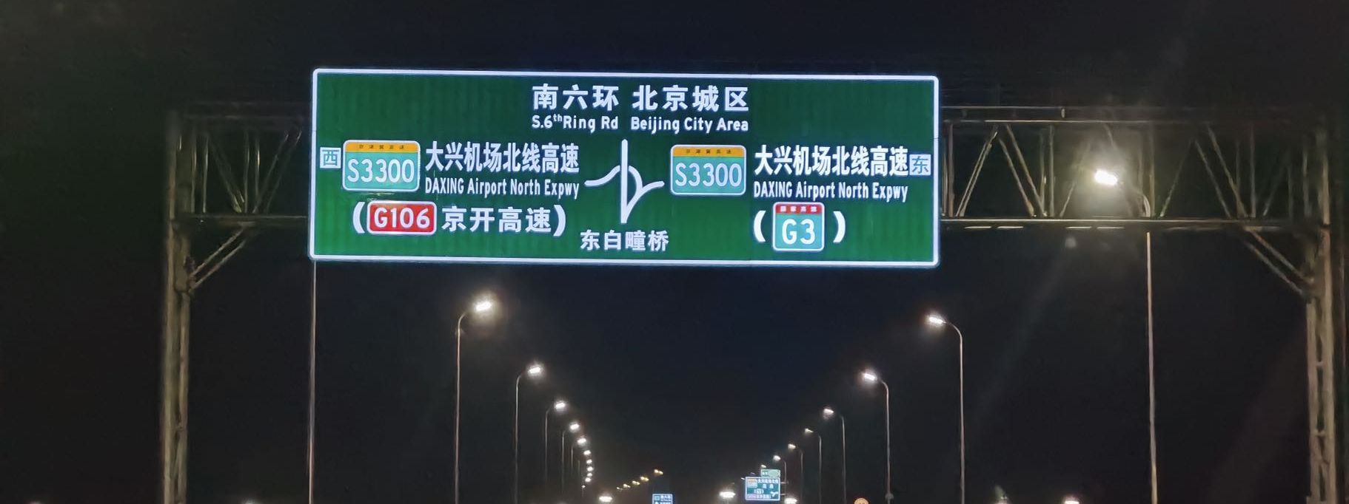
Self illuminated traffic signs

Slide 2
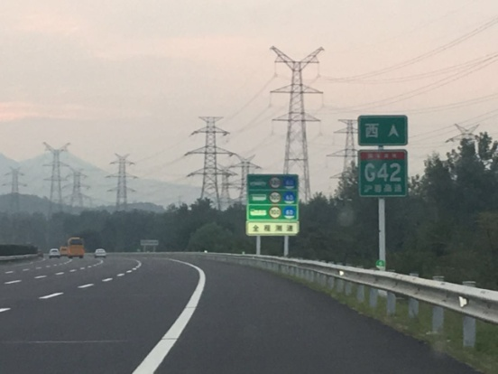
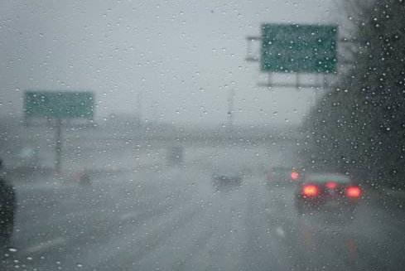
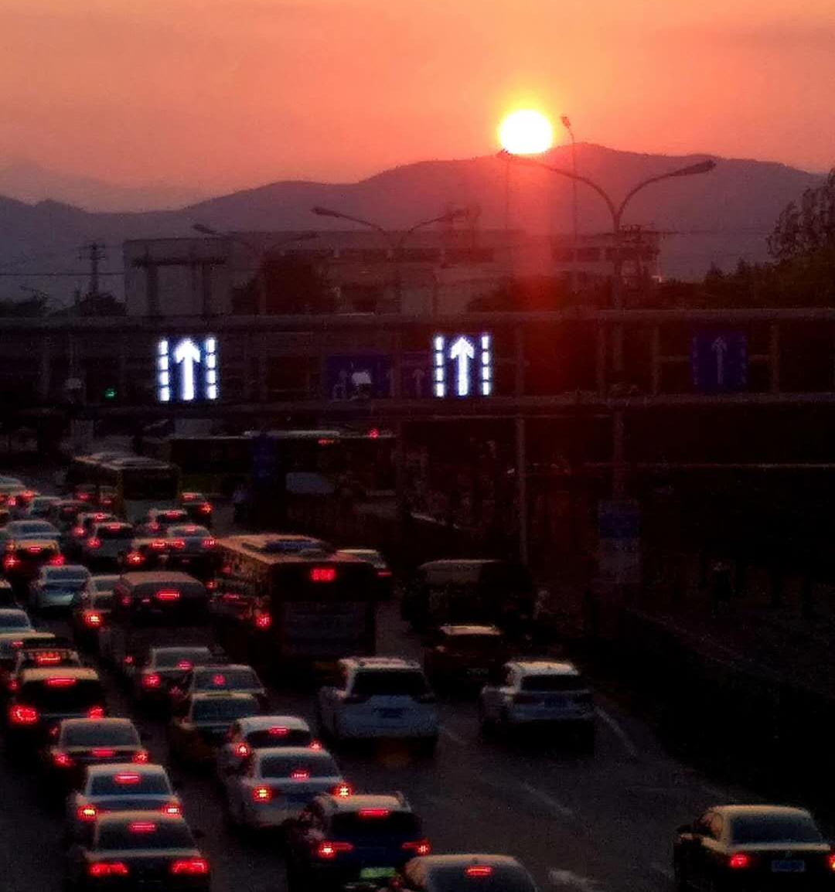
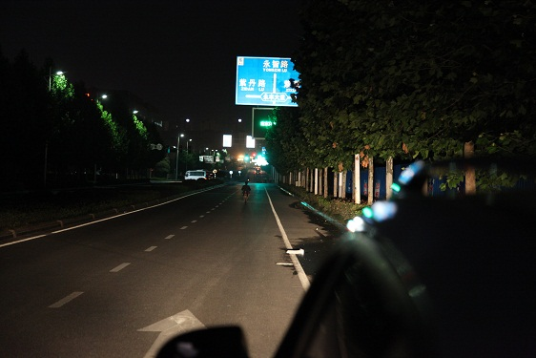
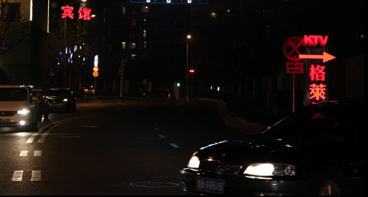
The deficiency of the traditional sign
Insufficient exposure to the curve slope section
Particulate matter in the rain, fog and haze air
Reverse light environment
City roads and other can not use high beams
Commercial lighting, environmental light is complex
Traditional signs rely on reflecting the light on the sign surface to provide nighttime vision
When the light cannot reach the surface of the sign, it cannot provide the night visual effect

Slide 3
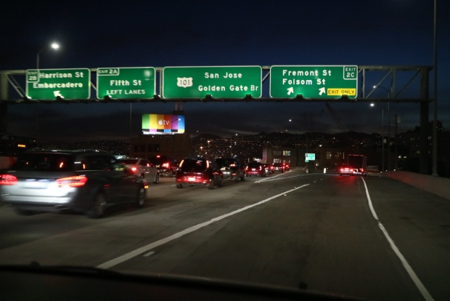
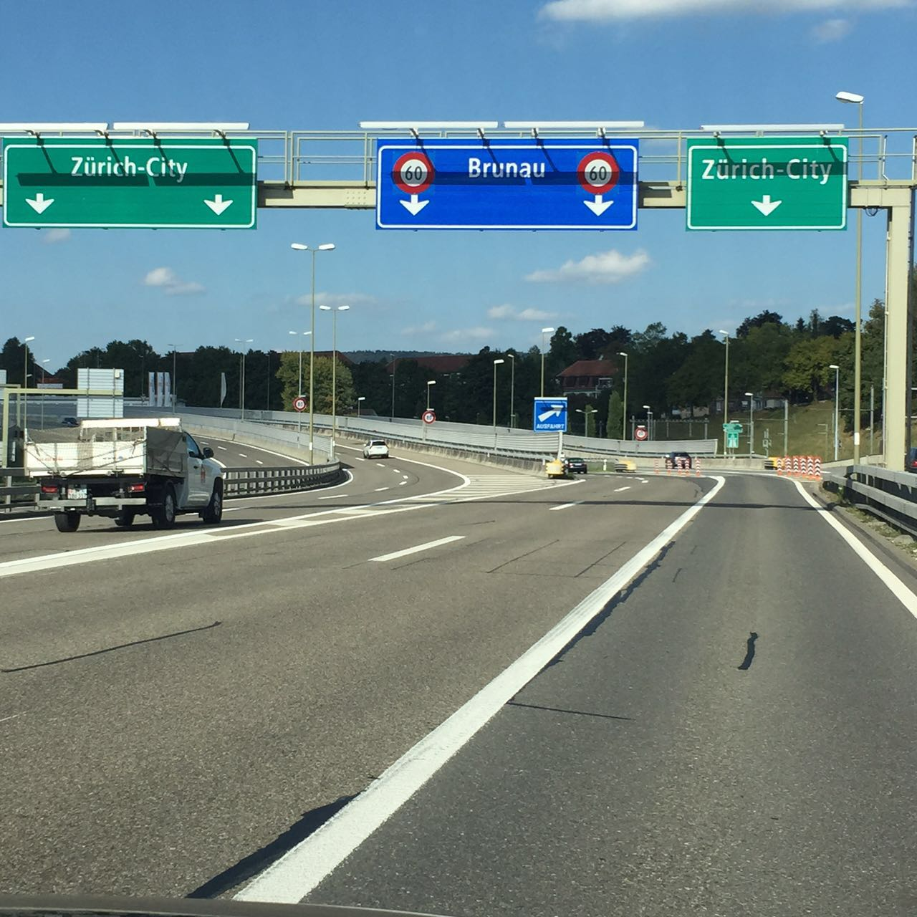
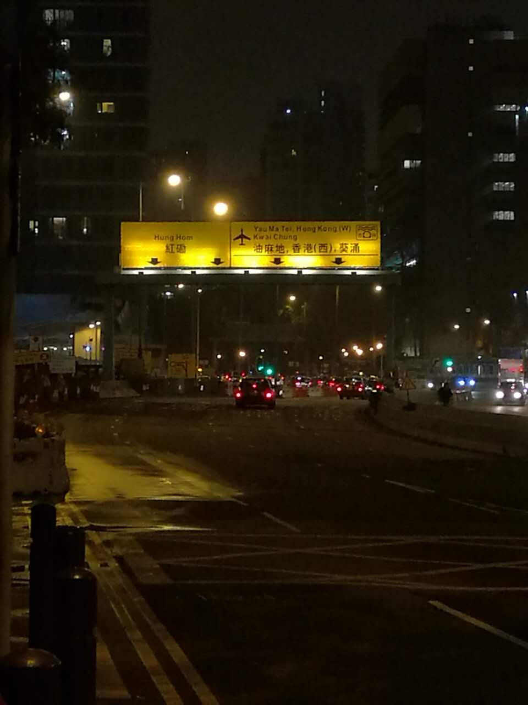
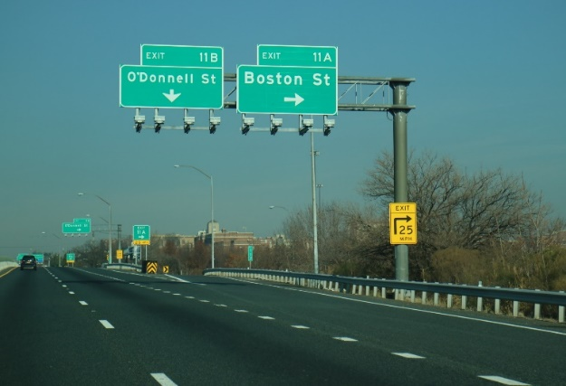
Add supplementary light lamps and lanterns
America
Europe
Hong Kong
Install light lamps with uneven illumination at night; shadows during the day
The rod needs to be redesigned and made, and the power consumption is relatively high

Slide 4
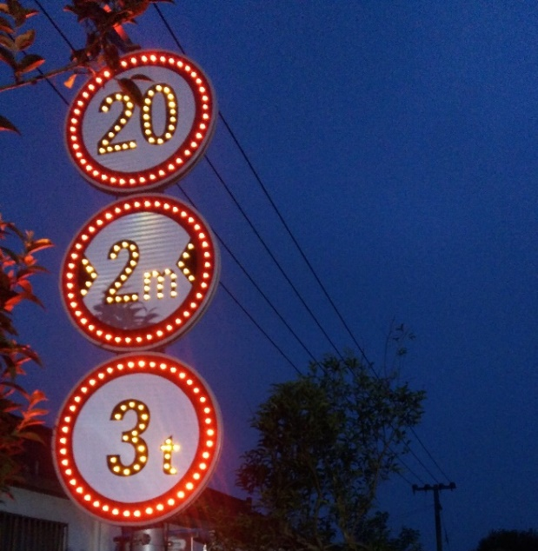
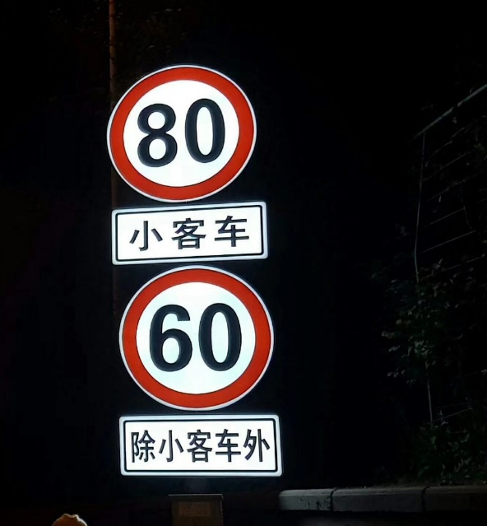
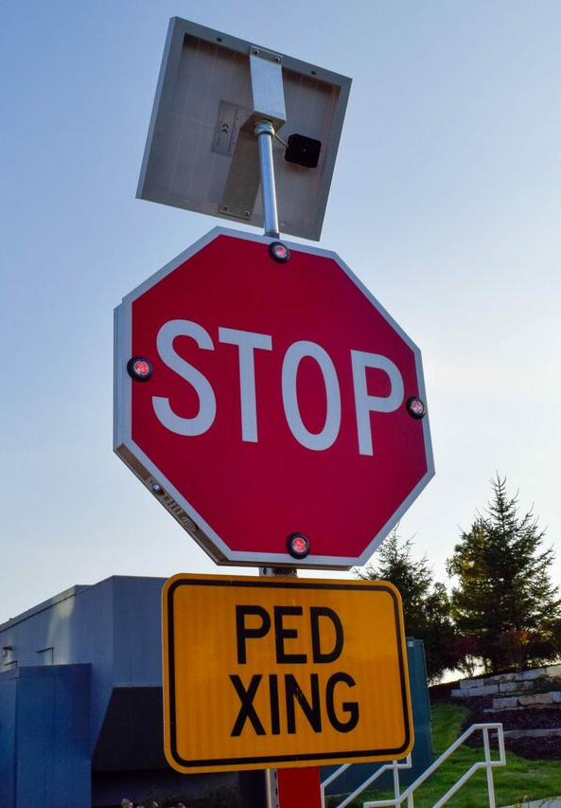
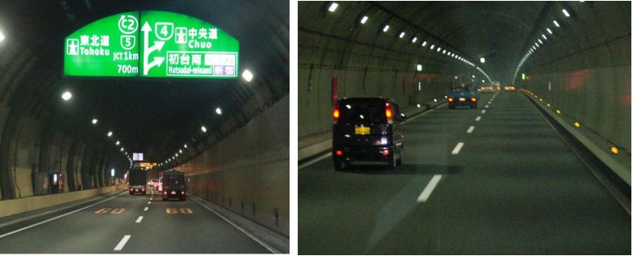
Apply the self illuminated sign
The dot matrix
Panel type
USA- -dot matrix
Japan-Panel-type
Shortly after the appearance of LED lamp beads, they were applied to the field of traffic signs to improve the recognition of signs
Dot matrix: use LED to outline the text, pattern; panel display type: use LED as the light source to project the pattern

Slide 5
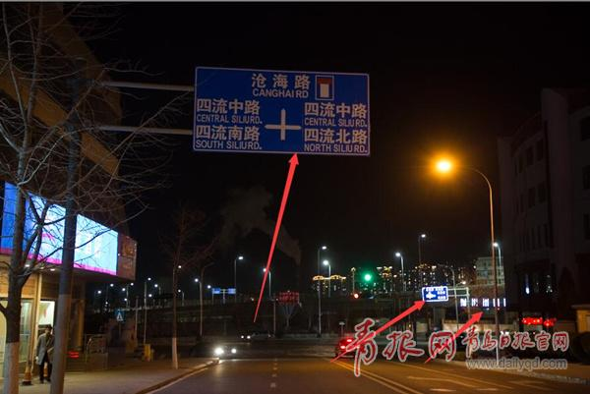
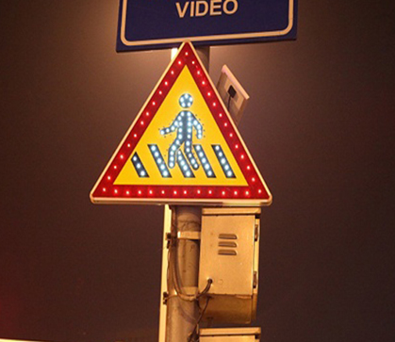
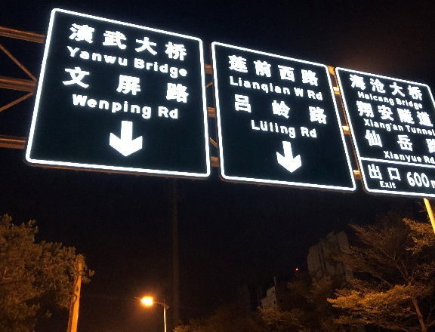
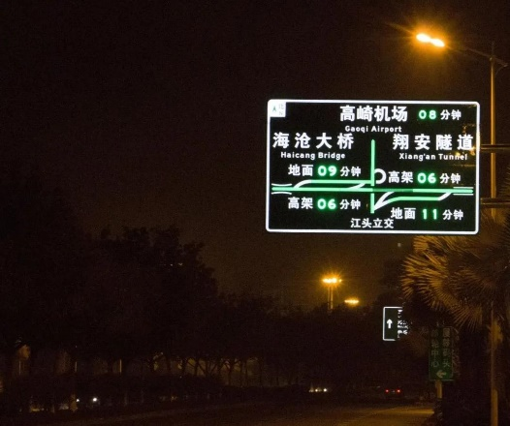
Development course of road traffic signs
In the early 20th century
The 1960s
In 2014,
Now
New technologies such as the Internet, cloud computing and big data are booming
General Electric Corporation develops LED light-emitting diodes
Seckang began developing LED panels to display active light road traffic signs
Reflective film was born
Inverse reflective traffic signs
Dot-matrix self illuminated sign
Panel displays the active luminescence sign
Intelligent and connected traffic signs

Slide 6




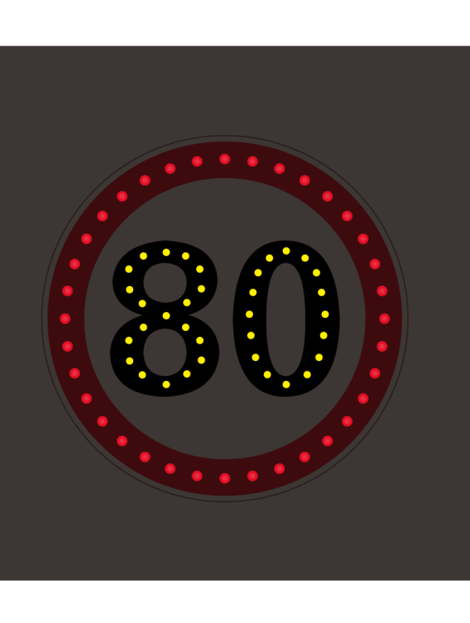

Dot-matrix self illuminated traffic sign
LED lamp beads + a lens
Black reflective film- -with punched holes
Red reflective film-punched holes
White reflective film-holes punched
Sign the panel-punch the hole
Frame profile
Baseboard

Slide 7
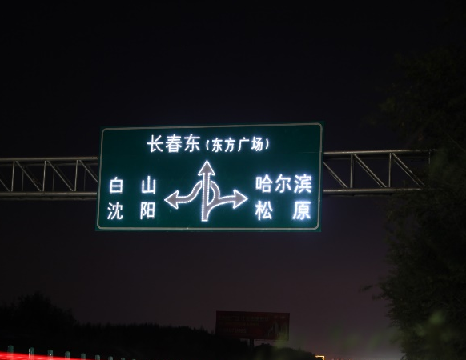
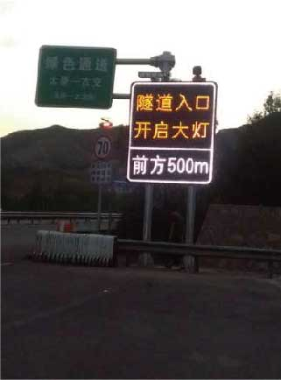
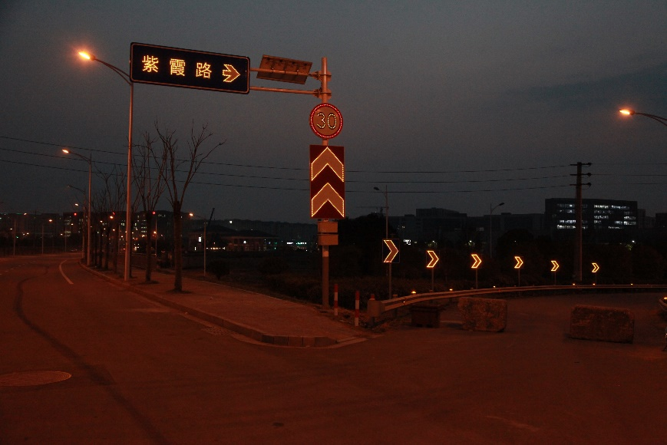
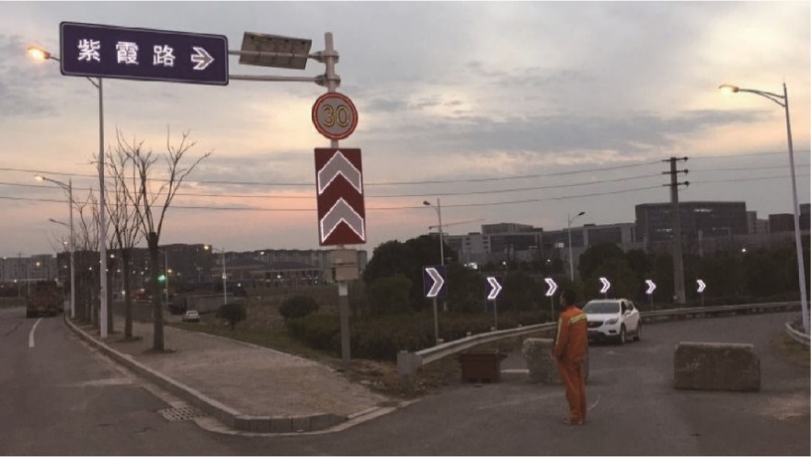
An example of a dot-matrix self illuminaterd traffic sign
Low power consumption, low cost, the lamp bead can change color temperature, more suitable for temporary signs
But there is glare, can only outline the pattern, text frame, can not clearly display the content of the sign

Slide 8


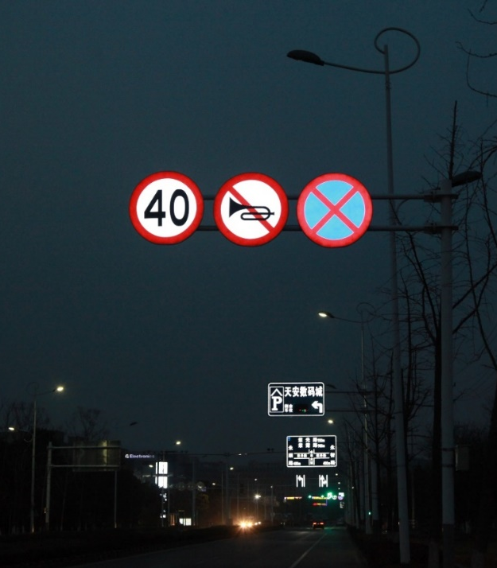
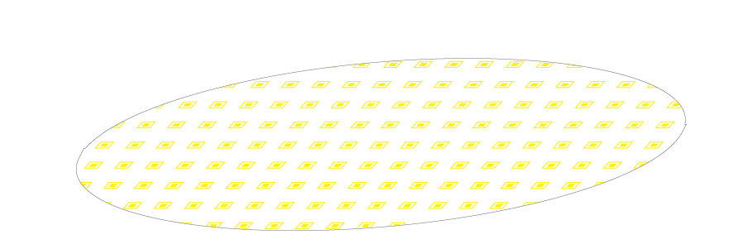

Full transmission self illuminated traffic sign
Black reflective film
Red reflective film
White high-light transmittance reflective film
The light plate
LED light source board
Frame profile
Baseboard

Slide 9


Examples of Full transmission self illuminated traffic sign
The night display effect is good, suitable for the ban, instructions, warning and other floor color has the legal meaning of the small sign
Limited by the size and structural strength of the transparent plate, it is not suitable to make the surface area too large

Slide 10



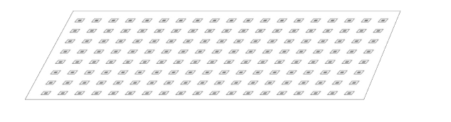
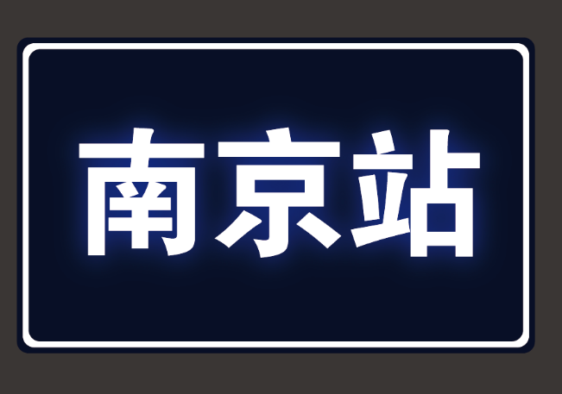

Semi-transparent self illuminated traffic sign
Text or pattern hollow-out reflective film
Apply a whole white high-light transmittance reflective film
Mosaic light transparent plate
Aluminum plate carved hollow-out text
LED light source board
Frame profile
Baseboard

Slide 11
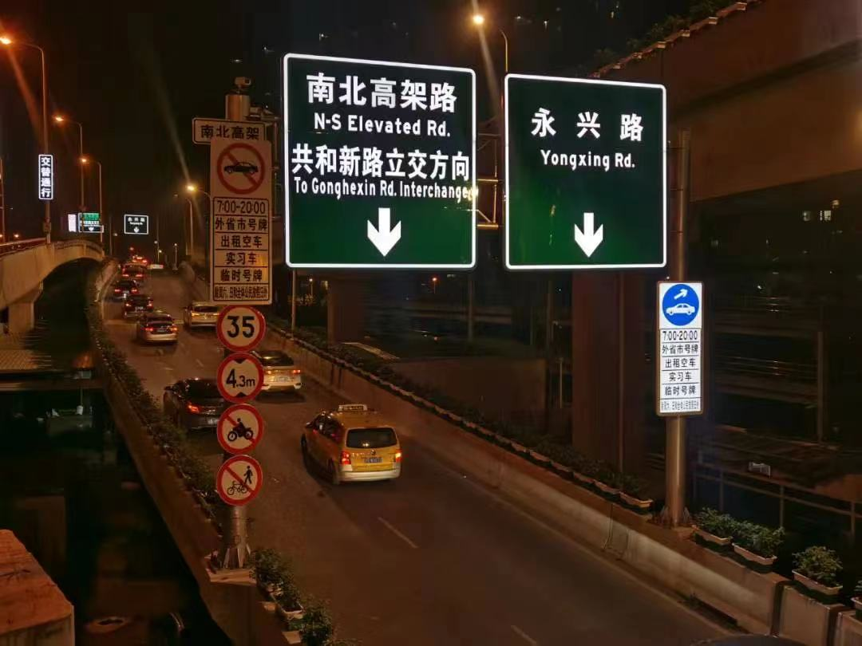
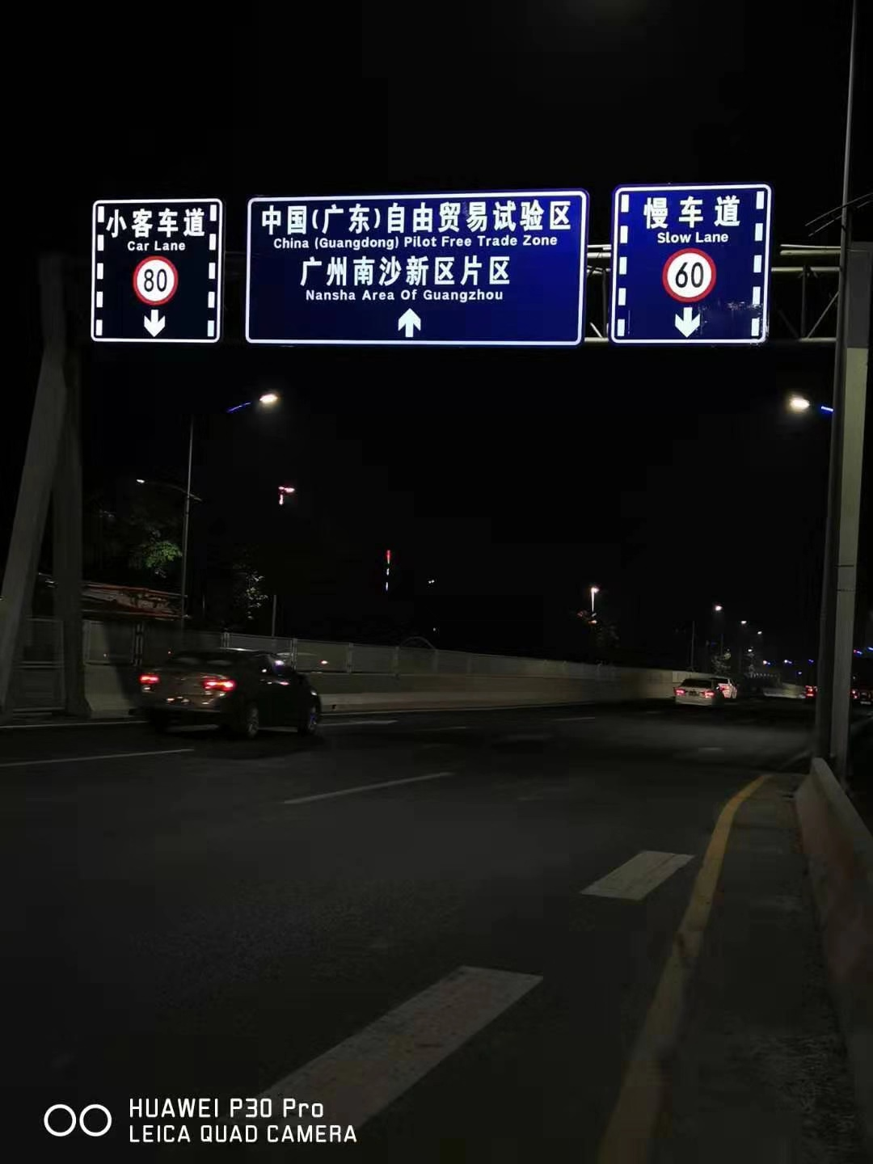
Examples of semi-transparent self illuminated traffic sign
Text, pattern and other information and the bottom plate contrast effect is obvious, has a better visual recognition effect
Can control the cost, power consumption and process difficulty

Slide 12
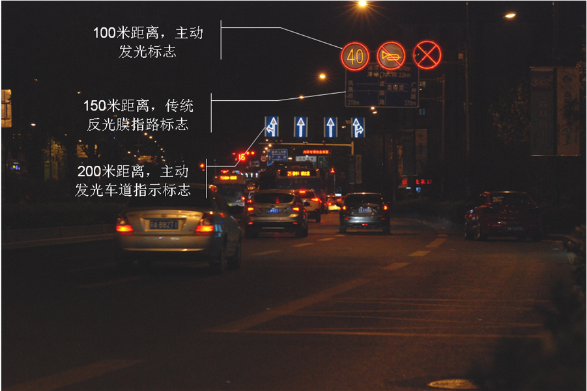
self illuminated traffic sign features
The self illuminated traffic sign has more balanced advantages in effect, cost, power consumption and other aspects
Recognize the effect | self illuminated | lattice | exterior lighting | retro reflection
cost of construction | exterior lighting | self illuminated | The dot matrix | retro reflection
power dissipation | exterior lighting | self illuminated | The dot matrix | retro reflection
Complex degree of process | self illuminated | The dot matrix | exterior lighting | retro reflection

Slide 13
applied code
type | LED self illuminated traffic sign |  | The dot matrix
 | semi-transparent type | Full transmission type
applied code | T / CSIA001-2018 Panel Display Active Light Traffic Sign |  | GB / T31446-2015 LED Active Luminous Road Traffic Sign
Reflective film selection | Class IV (class V white film transmittance effect is poor), white panel part transmittance of 25% |  | Not higher than Class IV
supply electricity | Electric supply | Mans (higher solar cost) | UPDATE, solar
power dissipation | ≤20W/m2 | ≤32W/m2 | ＜10W
weight | ≤22±3kg/m2 |  | -
install | As with ordinary signs, the poles that meet the requirements of GB / T23827-2009 Road Traffic Sign Board and Support Parts can be installed
Investment benefit | From the perspective of traffic safety economics, the VE value can reach 60-105 times and 3-5 times of traditional reflective signs (Test and evaluation of applying active luminous technology to improve road traffic safety in Tongji University 》)
Visual effect | (When the surface illumination of the sign environment is 100 Lx, the sign is automatically lit) The effective visual distance at night is 200m

Slide 14
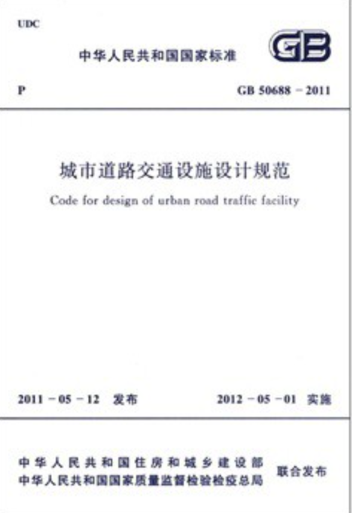
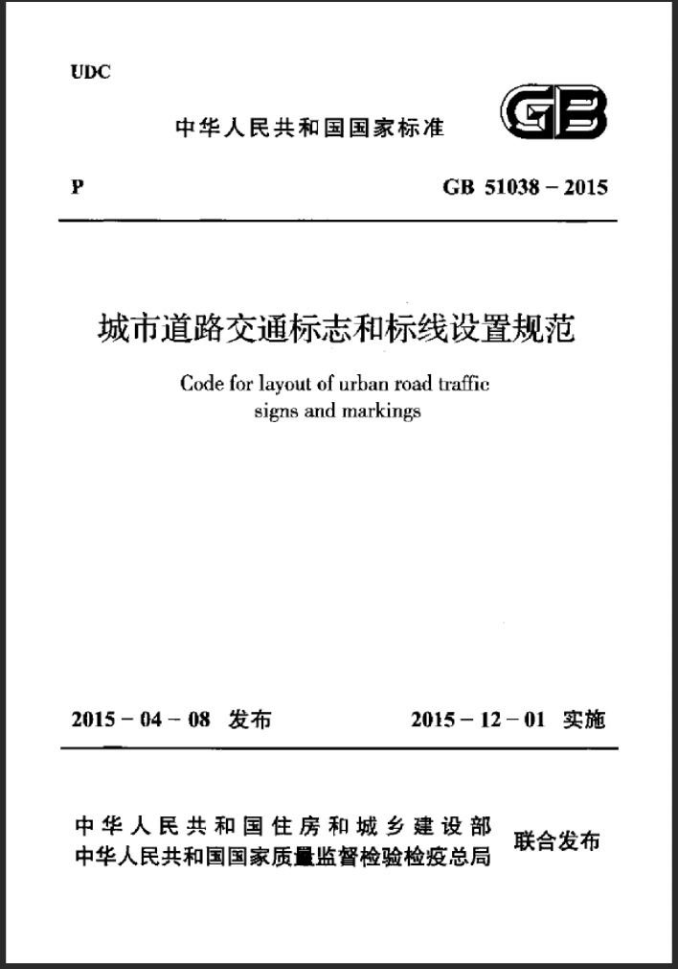
Development direction of engineering and technology field
Application trend of the active luminescence sign in the standard specification
GB 5768.2 Adopt (active) luminous type according to the terrain and sunshine conditions
GA / T 1548 Guide to the Setting of Active Lighting Signs on Urban Roads puts forward the scene of applicable active luminous signs
T / CECS 626-2019 Standard for Setting Urban Underground Road Traffic Signs and Marines shall be adopted by China Engineering Construction Standardization Association
The revised GB 50688 "Design Code for Urban Road Traffic Facilities" and GB 51038 "Code for Setting up Urban Road Traffic Marks and Line Marines" will add some sections of urban expressways and urban roads, and set up active luminous road traffic signs
Technical Regulations for Setting highway LED Traffic Signs submitted for review by China Engineering Construction Association
The field of engineering technology has also begun to pay attention to the problems of traditional traffic signs

Slide 15

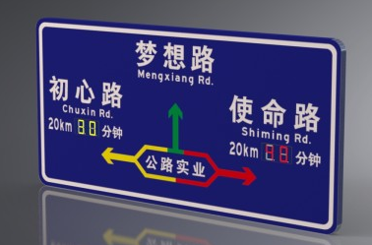

Intelligent network sign
Combine traffic signs with real-time traffic information
Traffic signs from, static information, release as the main direction, dynamic information, release iteration
Traffic signs to vehicle-road collaboration, Internet of vehicles, scene evolution
Real-time warning
Speed management
Traffic induced
Real-time risk perception and prompt
Combine path guidance with traffic information release
Traffic speed matches the traffic risk

Slide 16
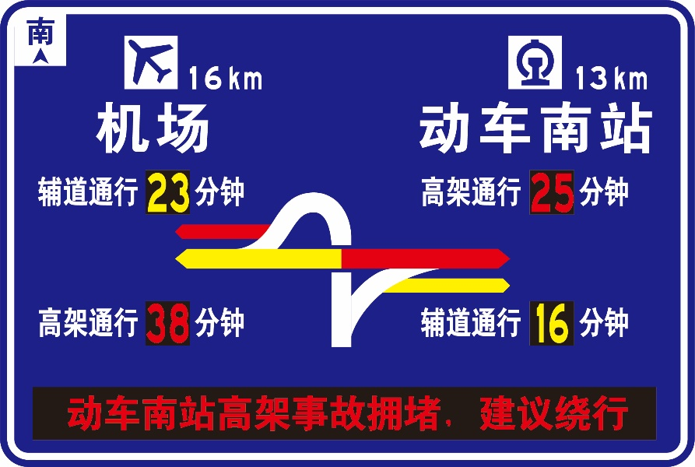
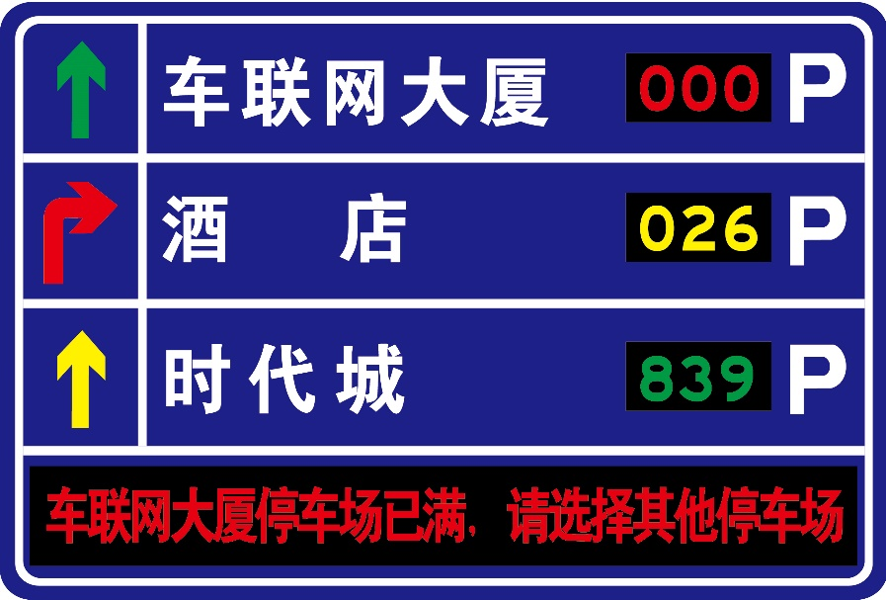

Intelligent network guide sign
The panel shows the semi-transparent active light emission sign
Deliver the road (space) information
LED Information Screen (digital)
Publish travel time information
LED information screen (light band)
Release road condition information
The panel shows the semi-transparent active light emission sign
Layout information of the surrounding parking facilities
LED Information Screen (Text)
Release information about traffic events
LED information screen (light band)
Guide the path and road condition
information
LED Information Screen (digital)
Release the remaining parking
space information

Slide 17
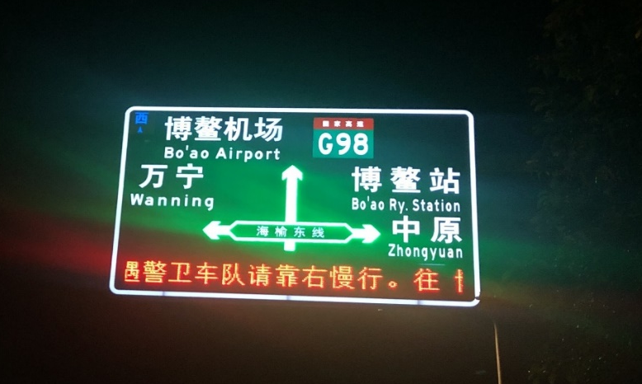
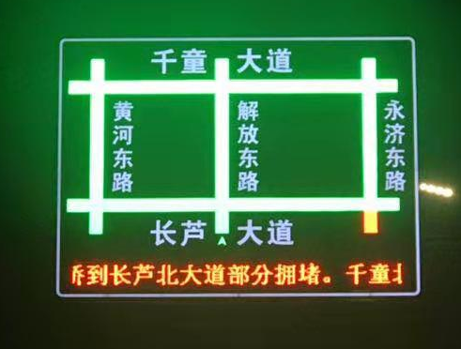
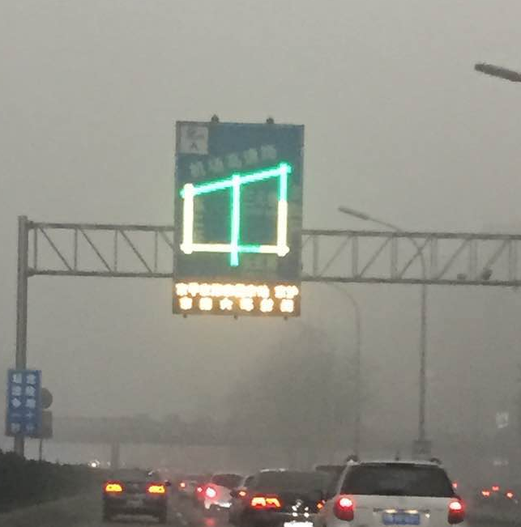
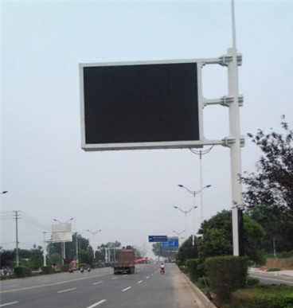
Compare this with other release schemes
Intelligent network guide sign
Display effect, energy consumption, cost and difficulty of installation are better
Common sign embedded LED display
LED display screen (variable intelligence board)
At night or under bad weather conditions, the LED display part can only be recognized, and it is difficult to obtain the layout information
In the power failure or abnormal conditions, no information can be provided, the lack of redundancy, can not replace the traffic signs. Since the significant, power consumption, cost, installation difficulty is higher

Slide 18
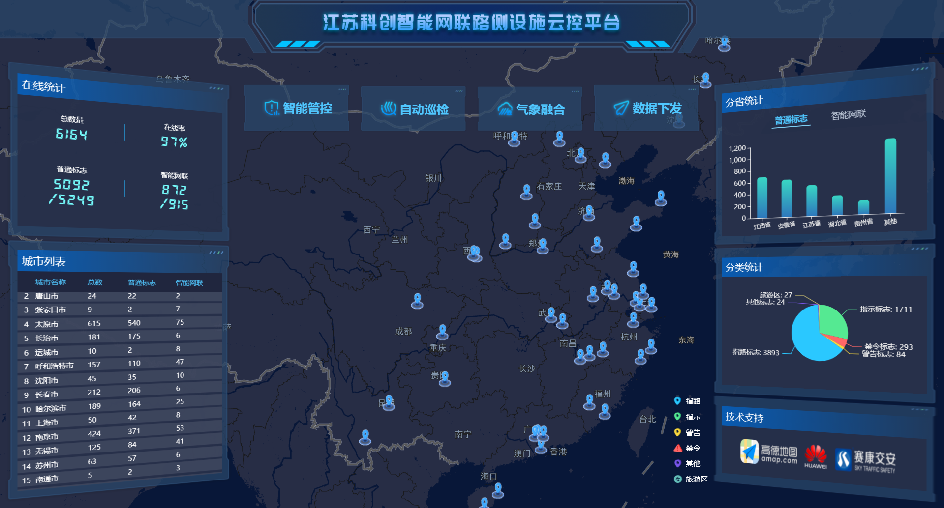
Cloud platforms provide data services
  Realize the integration of traffic signs, the whole life cycle management
  realizeData fusionAndCloud policy computing
  Implement the variable information flagDirective issued
  State monitoring
  Data fusion
  Cloud computing
  Strategy synergy
  Decision issuance
  health control
  telecontrol
  incident record
  Can be deployed in a private network
  You can connect with different data sources or other intelligent roadside devices

Slide 19
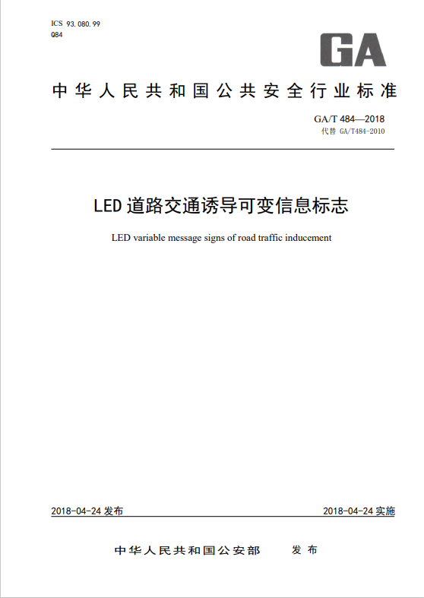

applied code
Technical standards applicable to intelligent network (guide) signs
GB 5768.2 Regulations on sign layout, color, font, layout, and variable information sign
GA / 484 LED Road Traffic induced Variable Information signs on local variable information signs
T / CSIA 007 Intelligent Network Guide Sign

Slide 20
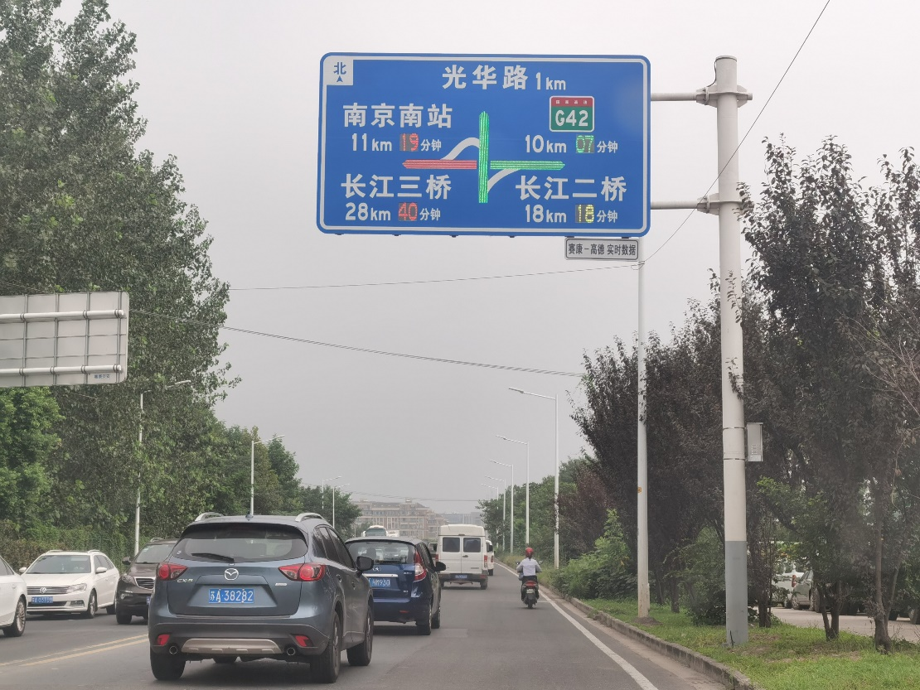
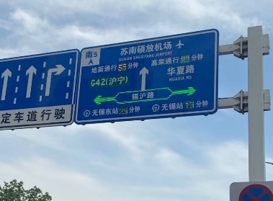
Typical application of intelligent network guide sign
City road scene
Nanjing · Baixia Park
Wuxi · Smart Transportation Project
Multipath induction of the key nodes
Combined with the road signs, continuous induction can be realized at multiple intersections in the road network

Slide 21
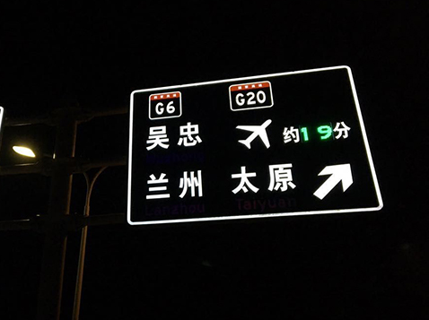
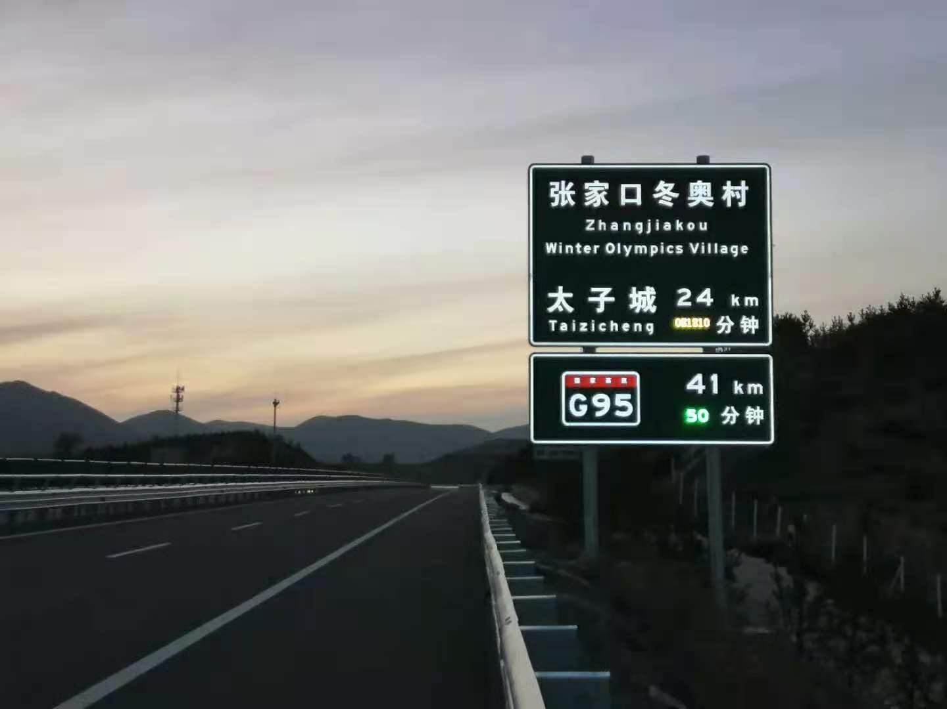
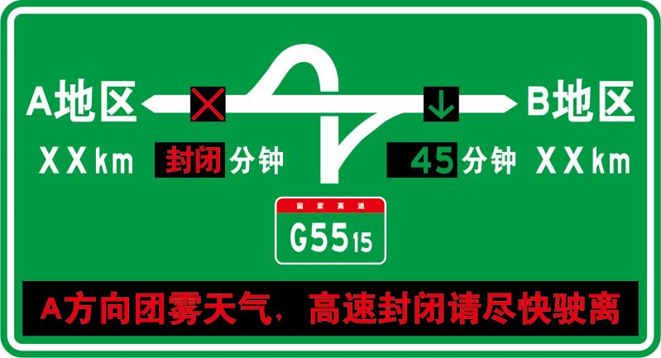
Typical application of intelligent network guide sign
Highway scene
Ningxia ·Smart high-speed
Hebei · Yanchong Expressway
Combined with the location distance sign to provide trip time information
Add traffic induction and traffic control information in the exit signs and bridge signs

